Slide 1


DevOps on Z
Suman Gopinath
Suman.Gopinath@in.ibm.com
Paul Pilotto

Slide 2
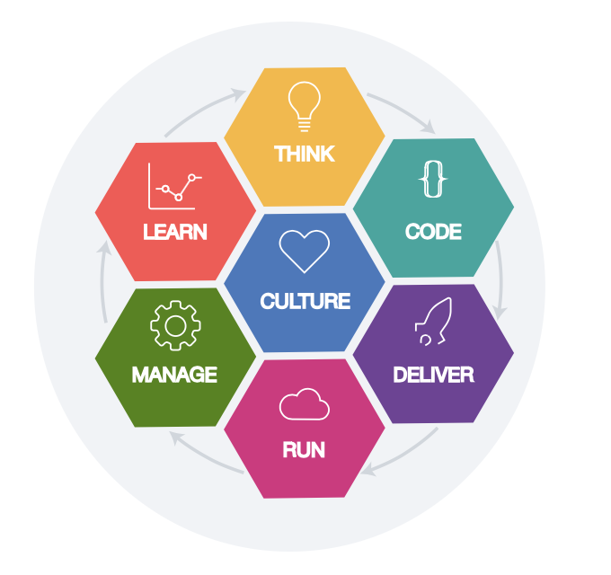




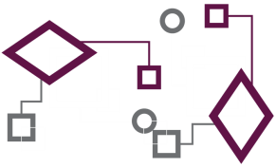

DevOps
End to End DevOps
HYBRID CLOUD
API Management
Notes:
Key Messages:
DevOps is not just Dev and Ops – it’s everyone and it’s all about culture.
It does not matter what platform or environment you are building for it’s the same DevOps
You don’t get the improvement you need by making multiple different ways of working with boundaries in between
You need an enterprise strategy
It’s a continual improvement process, you are never done, it’s all about removing waste from the system and continuing to improve
DevOps is all about culture but technology supports it
DevOps is Lean and Agile brought together for a continuous improvement process end to end
Enterprise strategy is required such that all audit process can be implemented clearly across the organization
DevOps is culture but technology supports it – you need a defined pipeline to support the process

Slide 3

Comparison of Software Stack Current State - Mainframe vs Distributed
Mainframe
Distributed
Pipeline Coordination
Jenkins
Release Mgmt
Host LM
UCR
Deployment Mgmt
Host LM
Jenkins, UCD, or Ansible
Artifact Repo
Artifactory or Nexus
Requirements/Tasks
Word or Excel
Issues or Jira
Quality Control
SonarQube
Testing
Manual
Multiple, JUnit, ZUnit
Source Control
Host LM
Git
Build
Host LM
Maven, Gradle, Make, DBB
Development
ISPF
Eclipse (IDz) , Visual Studio…
Notes:
Speaker: Suman
Despite the hybrid nature of our current and future state, most organizations still maintain separate tooling and processes for mainframe development.

Slide 4
To-be state after adopting IBM+Open Source
Mainframe
Distributed
Leverage existing cross-platform tools
Build on your current pipeline
Cross-train developers on familiar tooling
Pipeline Coordination
Jenkins
Release Mgmt
UCR
Deployment Mgmt
Jenkins or UCD or Ansible
Artifact Repo
Artifactory or Nexus
Requirements/Tasks
Issues or Jira
Quality Control
SonarQube
Testing
Multiple, JUnit, ZUnit
Source Control
Git
Build
Maven, Gradle, Make, DBB
Development
Eclipse (including IDz) , Visual Studio, …
Notes:
Speaker: Phil

Slide 5





End to End Strategy
An End to End strategy is necessary to set steps to be taken
A single or similar DevOps pipeline improves collaboration and reduces friction between teams
Workitems/Planning
Parallel Development
Test Environment Provisioning
Pipeline Automation
Development
SCM
Build
Artifact
Repository
Test Environments
Prod Environment
IDE, Impact Analysis Code Review, Unit Tests
Build, Code Quality
Test Automation, Code Coverage
Deployments

Slide 6
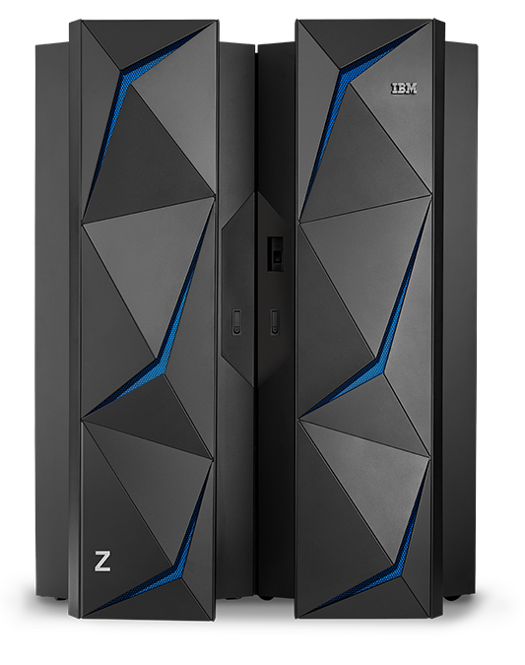
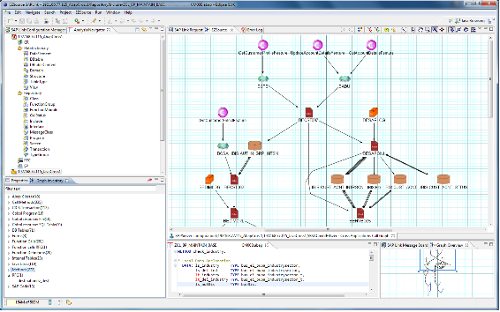
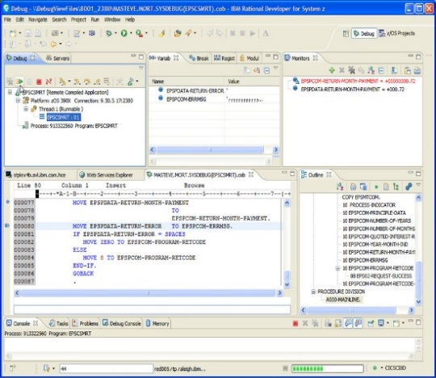
Modern Development Environment
Development
SCM
Build
Artifact
Repository
Test
Environments
Prod
Environment
Application Discovery and Delivery Intelligence (ADDI)
Application Delivery Foundation for Z
Reduce development and testing efforts 10-30%
Increase code quality by 50%
Plan and manage automation activities in 50% the time
Discover And Understand Your z/OS Assets, carry out impact analysis
Make changes and test effectively using operational feedback
Notes:
The cornerstone of the Modern Development solution is the Eclipse-based modern IDE, which has smooth integration with application analysis, fault analysis, file management, and application performance analysis capabilities. This integrated solution enables Innovation at greater speed and provides capabilities familiar and compelling to younger developers.
ADDI helps to understand your complex applications – As you are aware, analysis takes up 20-30% of a developer’s maintenance work. To find out the impact of these changes is also a huge task. ADDI is a static source code analysis tool that can help a developer easily understand his applications, find out where to make a change and also the impact of his change. It also helps you with trend analysis of your application quality, performance and code coverage by interfacing with code coverage, and performance tools.
Program structural and quality analysis tools: Helps developers deliver high quality COBOL and PL/I applications in a timely fashion that conform to in-house programming guidelines. Features include control flow diagrams for COBOL programs, identification and highlighting of potential unreachable code, data element tables showing all data elements for a given COBOL or PL/I program, a call hierarchy for showing caller and callee relationships, ability to open called programs from COBOL and PL/I source, and a code review feature allowing you to inspect your code for compliance with rules and best practices. Using the predefined COBOL and PL/I rules and templates, or your own custom written COBOL rules, you can run code review and view result interactively or in batch mode. Running code review in conjunction with your source control management system or other development processes provides code governance capabilities, as well as the opportunity to improve quality early in your development cycle.
Editor capabilities: COBOL, PLI, and JCL editor support includes improved navigation, content assist and real-time syntax checking, syntax highlighting, hyperlinks for copybooks, and include files, sequence numbers support, hover information for COPY and INCLUDE statements, refresh copybooks and includes when working with remote files, search for occurrences of a given variable, refactoring capabilities, enhanced outline view, JCL template, and open JCL Proc support.
IBM z/OS Debugger: A powerful, modern, GUI-based, multiplatform, multi-language, source-level debugger that enables the developer to step through the program being debugged, monitor and modify variables, set breakpoints during or prior to a debug session, and inspect program memory. This includes display and annotation of program execution flow.
Integration with your development toolchain: IBM's modern development solution offers seamless integration both IBM and non IBM tools, including:
Delivery as part of IBM Explorer for z/OS Aqua, 20 products that install together on the Eclipse-based Aqua platform
Integration with the industry's only enterprise, agile application lifecycle management solution that is inclusive of IBM Z applications, Rational Team Concert.
Integration for the market leading legacy SCM, CA Endevor Software Change Manager.
Support for the SonarLint for Eclipse plug-in
Plus the IBM Explorer for z/OS Atlas (Open Toolchain API) Technical Preview that enables flexible, scenario-based z/OS tools integration.
CICS and IMS Tools: Tools specifically for developers working with CICS Transaction Server ( CICS TS), IBM CICS Explorer®, IMS Transaction Manager (TM) and Database (DB).
Enterprise Service Tools for CICS and IMS: Provides an integrated set of tools that support modern application architectures and the transformation and reuse of existing CICS and IMS application processes. The tools support generation of web service descriptions and CICS service flow processing artifacts directly to a z/OS system.
Basic Mapping Support and Message Format Service Screen Designers: Enables you to visually create and modify Basic Mapping Support map sets and Message Format Service message and format files.
CICS and IMS Code Generators: Provides design tools and wizards which allow you to rapidly create CICS Transaction Server application code skeleton and logic from user-provided input. Provides code snippets which allow you to rapidly add common programming objects to IMS application code.
DB2 tools: Tools specifically for developers working with DB2 databases, stored procedures, and applications.
Data tools: Provides relational database tools to work with tables, table views, and filters. With these tools, you can create physical database models by means of reverse engineering database tables or using DDL scripts. You can also use the tools to create SQL statements, DB2 routines (such as stored procedures and user-defined functions), and several types of files, including SQLJ, SQL DDL, and XML files. Integration with Data Studio adds support to COBOL and PL/I programs for running, editing, and tuning EXEC SQL statements in the SQL Outline view.
z Systems stored procedures: Enables you to create, test, and deploy DB2 stored procedures written in COBOL, PL/I, Java, or SQL directly to a z/OS system.
Abend Analysis: Fault Analyzer for z/OS helps analyze and correct application failures quickly. Developers can receive a detailed report about program failures and resolve them quickly. It delivers information about an application at abend time and helps you determine what happened, and why, which program, what line of source code, and what variables were involved. Fault Analyzer can capture abends in z/OS, LE (Language Environment), CICS, IMS, DB2, MQ Series, and UNIX System Services environments for applications that are written in COBOL, PL/I, Assembler, C/C++ and Java. Analysis can be done real-time, interactively, and in batch mode via the user interface of choice (ISPF, CICS, browser, and Eclipse).
File Management: File Manager for z/OS allows you to manipulate production, test, and development data in a variety of data stores, including DB2, IMS, CICS, MQ, data sets (VSAM, QSAM, PDS, PDSE, IAM, and OAM), and HFS files. You can work in interactively using a formatted editor mode or in batch mode to manipulate data efficiently. File Manager can also be used for test data preparation, load module analysis, and offers simplified data access with improved search, navigation, access to remote systems via the user interface of choice (ISPF, CICS, and Eclipse).
Performance Analysis: Application Performance Analyzer for z/OS is a tool for measuring and reporting how applications use available resources on z/OS. It helps identify system constraints and improve application performance by providing the information needed to isolate performance problems in applications, plus it can test the effect of increased workloads on systems. It monitors, analyzes, and reports on both transactional and batch workloads, including CICS, DB2, IMS, WebSphere Application Server, MQ, and Adabas subsystems, and supports applications written in Assembler, COBOL (including ABO), PL/I, C/C++, Java, and Natural. Samples are collected from monitored address space(s) and analysis can be performed on the system or application usage of CPU, DASD, I/O of the total address space. Reports can be view online via ISPF or Eclipse, and also collected as PDF or XML files.

Slide 7


Why a modern Source Code Manager matters
Development
SCM
Build
Artifact
Repository
Test
Environments
Prod
Environment
Capability | GIT | Host SCM
Cross language / cross platform support
Branching / Streams – parallel development
“University grad friendly” – uses standard capabilities that new developers understand
Continuous Testing
Support for storing test cases along side of source code
Continuous Innovation
Common processes across teams
Open integrations
Host only configuration – can be complex configuration and upgrade
Host only source management
Limited traditional promotion paths
*Any flavor of Git – using the Rocket Software client on z/OS
IBM Z / © 2018 IBM Corporation
Notes:
One of the underplayed parts in the DevOps story is the SCM. The job interviews for distributed developers for startups ask for their github repository. Most fresh developers know and understand the concept of a distributed SCM. But this is still fairly neglected in the mainframe space. So why does a modern SCM matter. To a distributed developer or making changes for a release in say September – they can today create a new branch for Sep release and move their changes there. Take it through different environments without needing to merge it back. If there are changes that need to go in, there is always an option to merge. And the “merge” functionality is normally part of the SCM. If the team wants to bring in some innovative processes like code reviews and automatic unit tests whenever they check in code, that is also easily manageable. Now contrast that with traditional mainframe Host based SCMs. The developer and the team have fixed environments and fixed promotion paths. If there are conflicting changes, and if someone is diligently performing code compares every now and then – they would know that the code they are working on is not part of the production copy. But how many times have such things been overlooked. It is not unheard of, in mainframe applications for untested code to go into production because the changes were accidentally mixed with someone else’s changes. The way customers tackle this is to either have a code freeze, multiple manual checks or a waterfall – serialized promotion process – wait for the other team’s changes to move to next env before you move your changes in. This way of working has been taken as “this is the mainframe system, that’s the way it works” for years.

Slide 8
IBM Dependency Based Build (DBB)
Development
SCM
Build
Artifact
Repository
Test
Environments
Prod
Environment
IBM Dependency Based Build (DBB) - Intelligent build environment for applications stored in Git
Build frame work for z/OS applications stored in Git
Consists of a Liberty application server that hosts metadata (dependency data, build results) and a build toolkit (Java API, Groovy Installation).
Groovy driven build environment for compiling, linking and processing z/OS programs and applications
Dependency identification and understanding
Automatically identify program dependencies and present the information to the developer/tester
Build intelligently based on dependencies
Give the tester the option to selectively and automatically build impacted artifacts
Integration with any CI tooling (Jenkins etc)
Notes:
Dependency Based Build is an intelligent build system that allows to identify dependencies during a build – impacted programs from a copybook change etc. This is an inherent part of RTC EE. Last March, IBM released a build toolkit called IBM DBB nby itself. It works on the same dependency building that is in RTC but it also allows you to use a modern SCM for your application source code. IBM’s Dependency Based Build is a build toolkit that allows you to build traditional z/OS Applications based on COBOL, PL/1, CICS, DB2, IMS etc., stored in a distributed open source SCM. It is not tied to a specific source code management or pipeline automation tool. It consists of APIs and scripts that allow you to easily compile and link edit your Application code on USS – making it possible to store your source code in any Open Source SCM that can handle the EBCDIC conversion. It consists of a liberty server for hosting the dependency data and th ebuild results and then a build toolkit which has a groovy installation and a bunch of Java Apis that enable you to easily compile and build zOS application code.

Slide 9
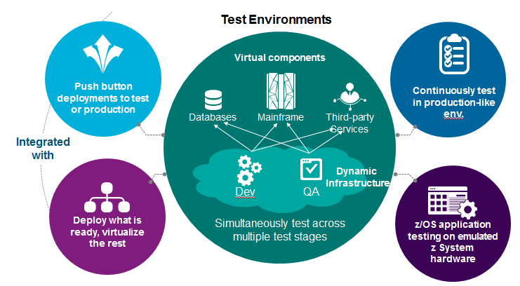
Shift Left Testing
Development
SCM
Build
Artifact
Repository
Test
Environments
Prod
Environment
Ability to automate all levels of testing - Unit, Integration, Regression
An Agile Source Code Management system that supports true parallel development to enable parallel testing
Isolated On-demand Test Environments with planned Test Data Management to support parallel development and testing.
Ability to run sub-set of Batch cycles before End-to-End Integration testing
Ability to virtualize interfaces
Ability to integrate into a DevOps Pipeline
Notes:
So in a generic mainframe Application maintenance scenario, the majority of manual effort that is spent is mostly in Analysis and Testing. We have seen how ADDI in analysis helps to bring down that effort. So what about the testing space. It is important to have the ability to automate all levels of testing – Unit, Integration and Regression. As we saw from the first chart, a business capability is driven by multiple applications – distributed and mainframe put together. While it is important to test all this together, it is equally important that you have the ability to test your individual applciations much earlier so that defects that could have been fixed earlier are not found in the nth moment. And for this you need to have 1) the ability to test as and when you want in “on-demand” environments, instead of waiting for test environments – worrying about data corruption 2) have the ability to virtualize your interfaces so that you are not dependent on other systems for testing of your functionaltiy. And lastly, whatever automation you do – it should be possible to integrate that into an automated pipeline

Slide 10

Unit Testing
Development
SCM
Build
Artifact
Repository
Test
Environments
Prod
Environment
By testing Individual units/programs, it is possible to capture coding defects much earlier in the cycle before the functional and regression testing.
IBM Developer for z Systems
Developer
What is zUnit?
Automated Unit Testing based on the X-Unit framework
Wizard driven Test case generation based on User input and expected output
Generated Unit Tests are COBOL/PL1 programs that can be stored in the SCM and invoked with every build – Starting point of Testing Automation and building a CICD pipeline
Test cases can be bundled into Test Suites
zUnit Test Runner allows assertions and Automated Fail/Pass Checks
Integrated Code Coverage capability
Encourage Behavior Driven Development with the use of stubs and mocks
Notes:
Ask how they do unit testing – If no answer talk about running the whole transaction and either putting displays or debugging to ensure that changed code is tested. Or else running a batch job and checking for a return code of zero. Ask if they have heard of jUnit, Xunit, test driven development. Xunit is a simple framework that can help in unit testing. So basically, you will write programs for testing your changes using the xUnit framework and you will be able to use the framework to run assertions automated fail/pass checks etc. zUnit is essentially based on xUnit framework. But instead of making the developers code the program, it generates a COBOL or PL1 test case program based on user input. So essentially, you will have a test case program for every program. This can be checked into the SCM that you are using. And these testcase programs will have unit tests. They can be modified and maintained like any other program. zUnit also allows you to mock your program calls. So lets say you have to test a paragraph in a program but there is a program call before this paragraph and your paragraph is never reached because of data issues with this external call. zUnit allows you to mock all such calls so that you can test just your program logic. In the distributed world, whenever a java method or class is changed, there are a bunch of jUnit test cases that are invoked. This is the unit test automation that we’d like to bring with zUnit.

Slide 11


Functional/Regression Testing
Development
SCM
Build
Artifact
Repository
Test
Environments
Prod
Environment
Automate Regression Test Packs – Run regression tests after deployment to each environment
Automate Functional Testing and virtualize interfaces that are not available
IBM Rational Test Workbench
Enable performance, integration and functional testing, including terminal based, throughout your project lifecycle
With a scriptless, wizard-driven test authoring environment and support for more than 70 technologies and protocols
IBM Rational Performance Test Server
Save time and effort by reusing your functional integration tests for performance testing
Combine your tests to model real-world scenarios and assess the impact of load on your integrated infrastructure.
IBM Rational Test Virtualization Server
Model real system behavior to eliminate test dependencies and simulate production,
Accelerate testing and reduce the setup and infrastructure costs of traditional testing environments.
QA
DEV
Test Workbench
Functional Testing Integration Testing Performance Testing Regression Testing
Test Servers
Load Agents Virtualization Agents
Test Lab Infrastructure
Notes:
In the Integration and Regression testing space, we have the Rational Test Workbench with performance tester and the Virtualization that we spoke about earlier

Slide 12
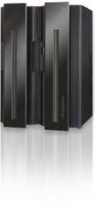

Test Environments
Development
SCM
Build
Artifact
Repository
Test
Environments
Prod
Environment
Availability of Isolated environments is a key to Early Testing
Developers to perform unit tests without interference from other teams
Environment for Testers to run part of Batch schedules in isolation before full batch run without impacting other teams – e.g Gain the ability to change logical dates and run more than one batch cycles in a day
Enables Continuous Integration and Agile Development methodologies for z/OS
Faster and Easier Provisioning of Test Environments on demand or as part of a DevOps Pipeline
Elimination of shared data issues
Enable developer autonomy and self-service in creating environments
Supports Cloud deployments – enables easy stand up and stand down of environments
Affordable off host development _{and test environment}
_{COBOL, PL/I, C++, Java,}
_{EGL, Batch, Assembler,}
_{RTC}
_{RIT}
_{UCD}
_{IDz}
_{DT}
_{IMS}
_{CICS}
_{DB2}
_{WAS}
_{MQ}
_{z/OS}
_{zD&T}
X86 Hardware running 64-bit Linux
_{Cloud Infrastructure}
Notes:
What about the ability to spin up environments as and when required – It is very common in distributed systems to have environments more than that is necessary for your testing . E.g quote some of our product environments (200-300 servers??). But in the mainframe space, we still struggle with getting environments, we run into data issues - data corrupted by others using the shared env, choking of CPU cycles in Dev at the end of the month etc. Essentially, the concept of having a separate environment to test just your application changes is non-existant. zD&T is a product that emulates the mainframe on an x86 and allows you to install the z/OS and the other software that run on Z on this system. There is no change in the software that is in zD&T. CICS or DB2 does not come up with a different version it is the same software on Z that can be in zD&T. zD&T also comes with provisioning tools that allow you to select applciation images and provision them on to linux system – which could be on internal or public cloud or on a physical machine. So essentially, what you get is the capability to literally right click from IDz and provision a new image of your application in an x86 machine that can be used for your testing. We have customers who had to wait for days on – 1.5 months to be precise for a particular testing – because it required the shift of logical days And they couldn't’t just advance these days as it would impact everyone else. When they used an individual zD&T system for their project, it gave them the ability to finish their testing in 8 days. Compare that to 1.5 months and then the number of such projects,

Slide 13
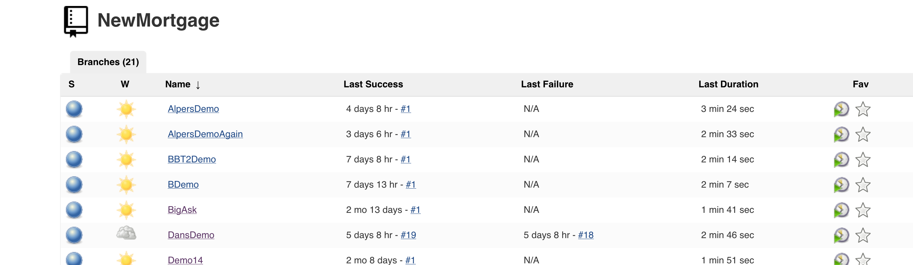
Continuous Integration & Deployment
Development
SCM
Build
Artifact
Repository
Test
Environments
Prod
Environment
Jenkins
Open Source Continuous Integration tool that helps to bring together the pipeline process
Has plugins that allow you to connect and work with various tools
Uses a form of Groovy - Allows you to create pipeline scripts that can be SCM Managed
Jenkins slave runs on the USS to run scripts on z/OS– ZOD has sample scripts that can be used to run conversions when using Jenkins slave
Popular Alternatives
GitLab CI – Working to enable this on Z
Bamboo

Slide 14
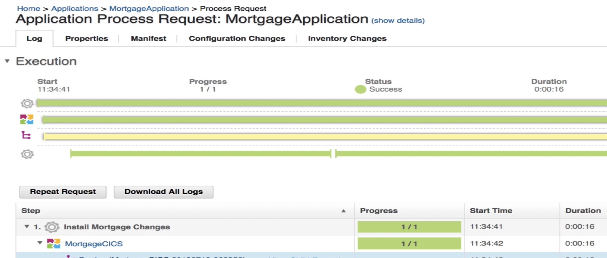
Continuous Integration & Deployment
Development
SCM
Build
Artifact
Repository
Test
Environments
Prod
Environment
Urbancode Deploy
Deployment orchestration for Distributed and z/OS Applications – including CICS, Db2, MQ, across multiple environments
Integrates with Jenkins
Manages artifact versions via an in-built repository called codestation

Slide 15
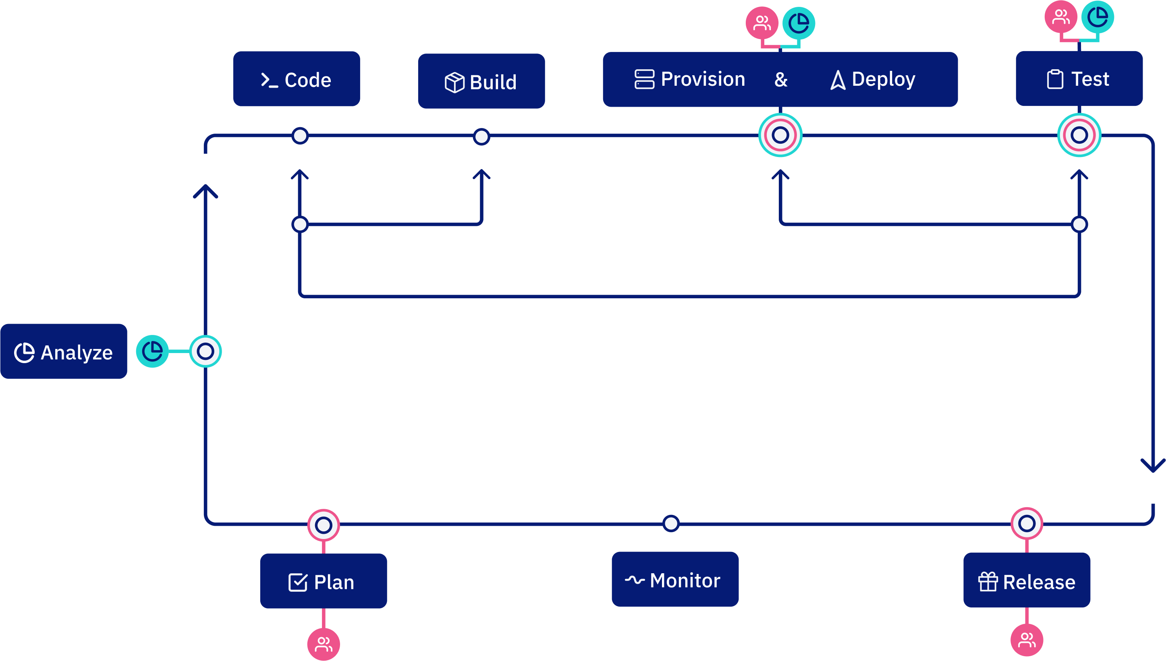
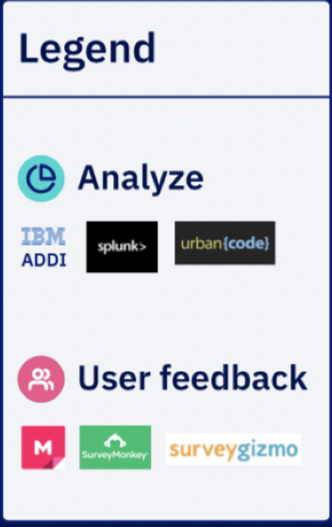
The Pipeline
Notes:
What we want to do is provide this pipeline as the automation framework for the DevOps transformation
Everyone is a developer

Slide 16
Demo

Slide 17









What did the demo show?
Issues
Plan
Build
Deploy
Test
Source
Build
Unit Tests
Code Review
>_ Code
zD&T
IBM Z

Slide 18
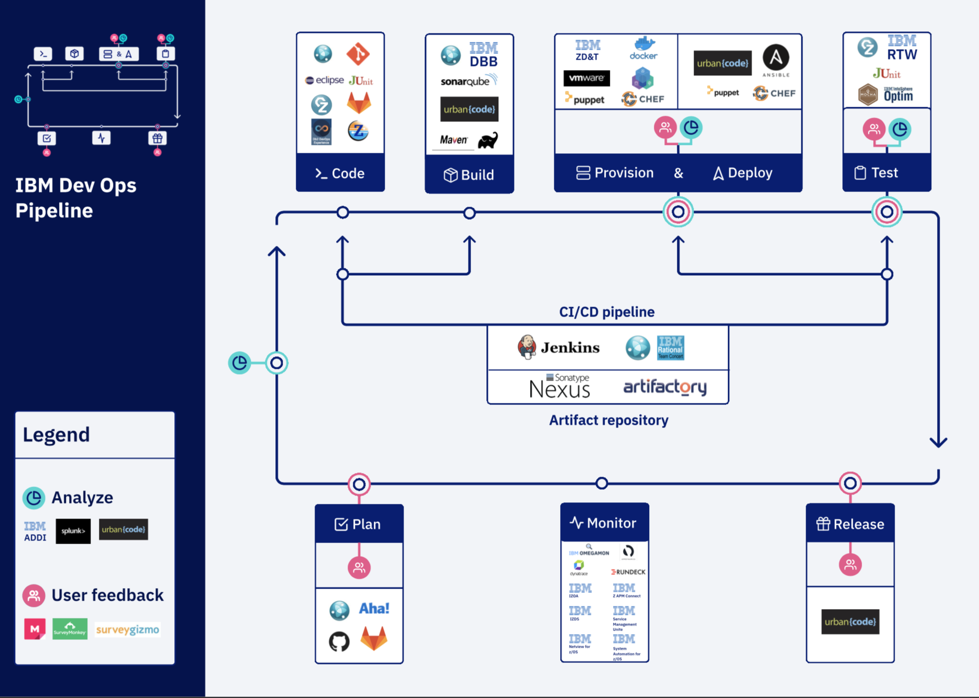
The IBM Way – A Sample

Slide 19
IBM Z DevOps and Azure DevOps
An alternative DevOps Pipeline using IBM and Microsoft solutions

Slide 20


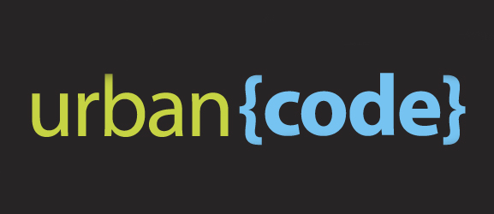
Architecture – VS Code, Azure, DBB & Urban Code Deploy
Developer PC
Linux Srvr
ZOS/ USS
VS Code & WAZI
Pipeline
Run Git Clone script
Run DBB Build
Run Urban Code Buztool
On Prem
Linux
Azure Agent
SSH
Clone Repo
C
Git repo
Developer Commits changes to Local repo
DBB Build
D
Push Triggers a Pipeline
B
Artifacts
local
Repo
Azure Repo
Rocket Clone
Urban Code Buztool
E
Mortgage-App
A
Git clone
Nelson Lopez (IBM Z DevOps - DAT Team/RTP)

Slide 21
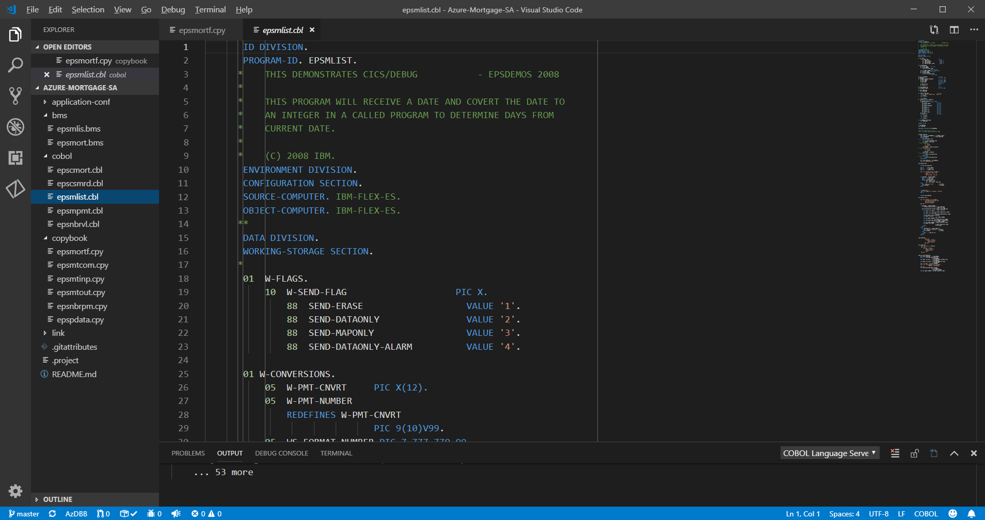
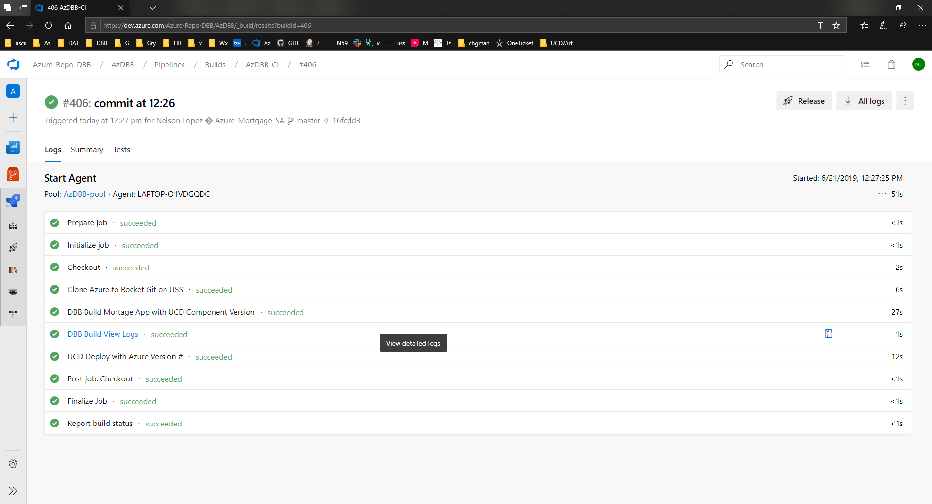
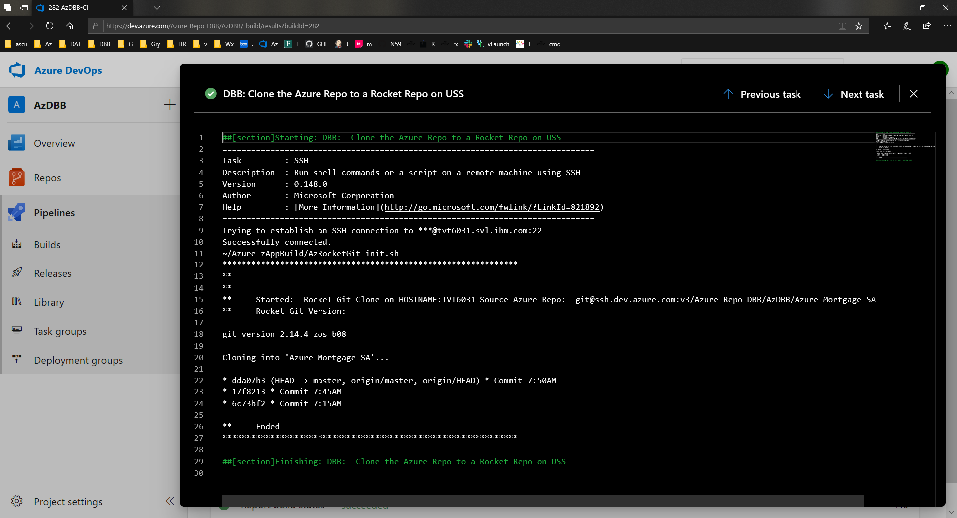
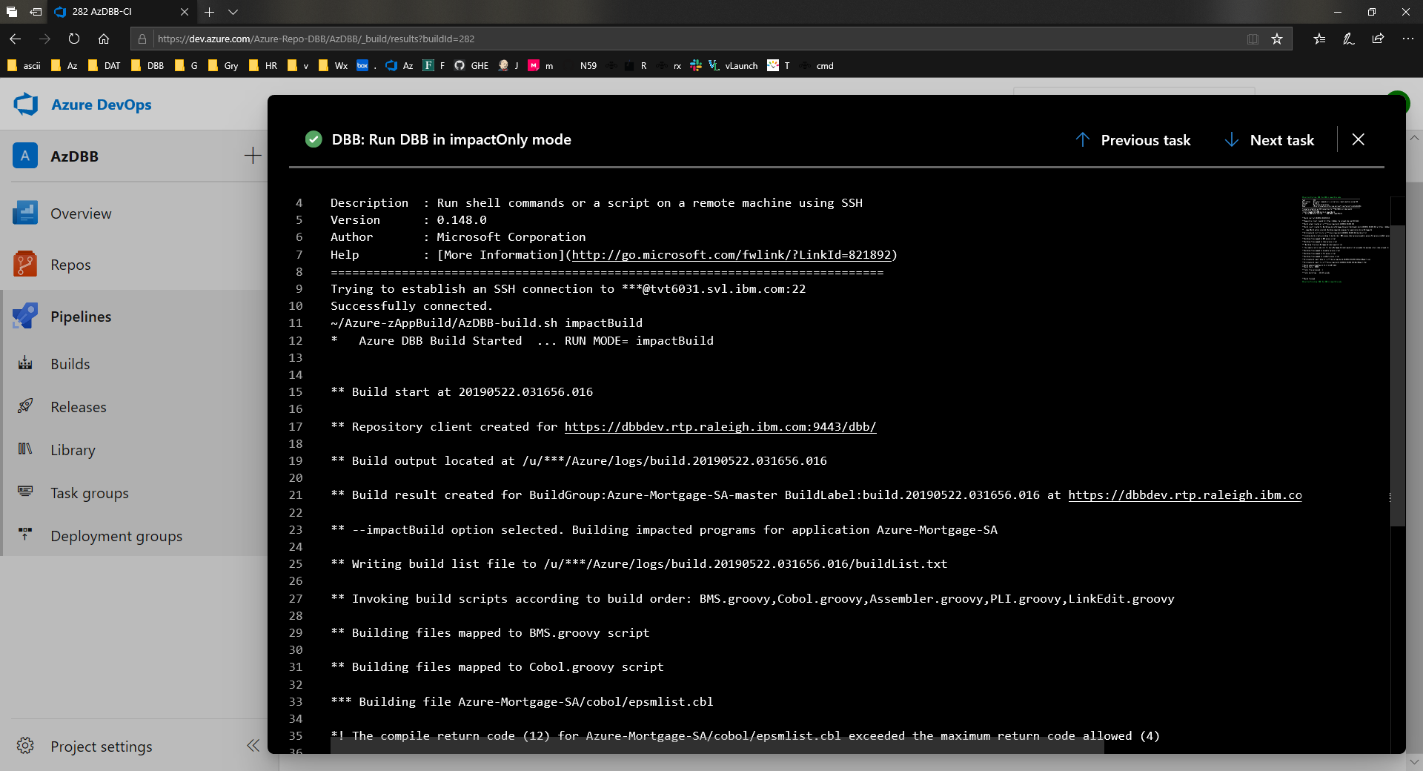
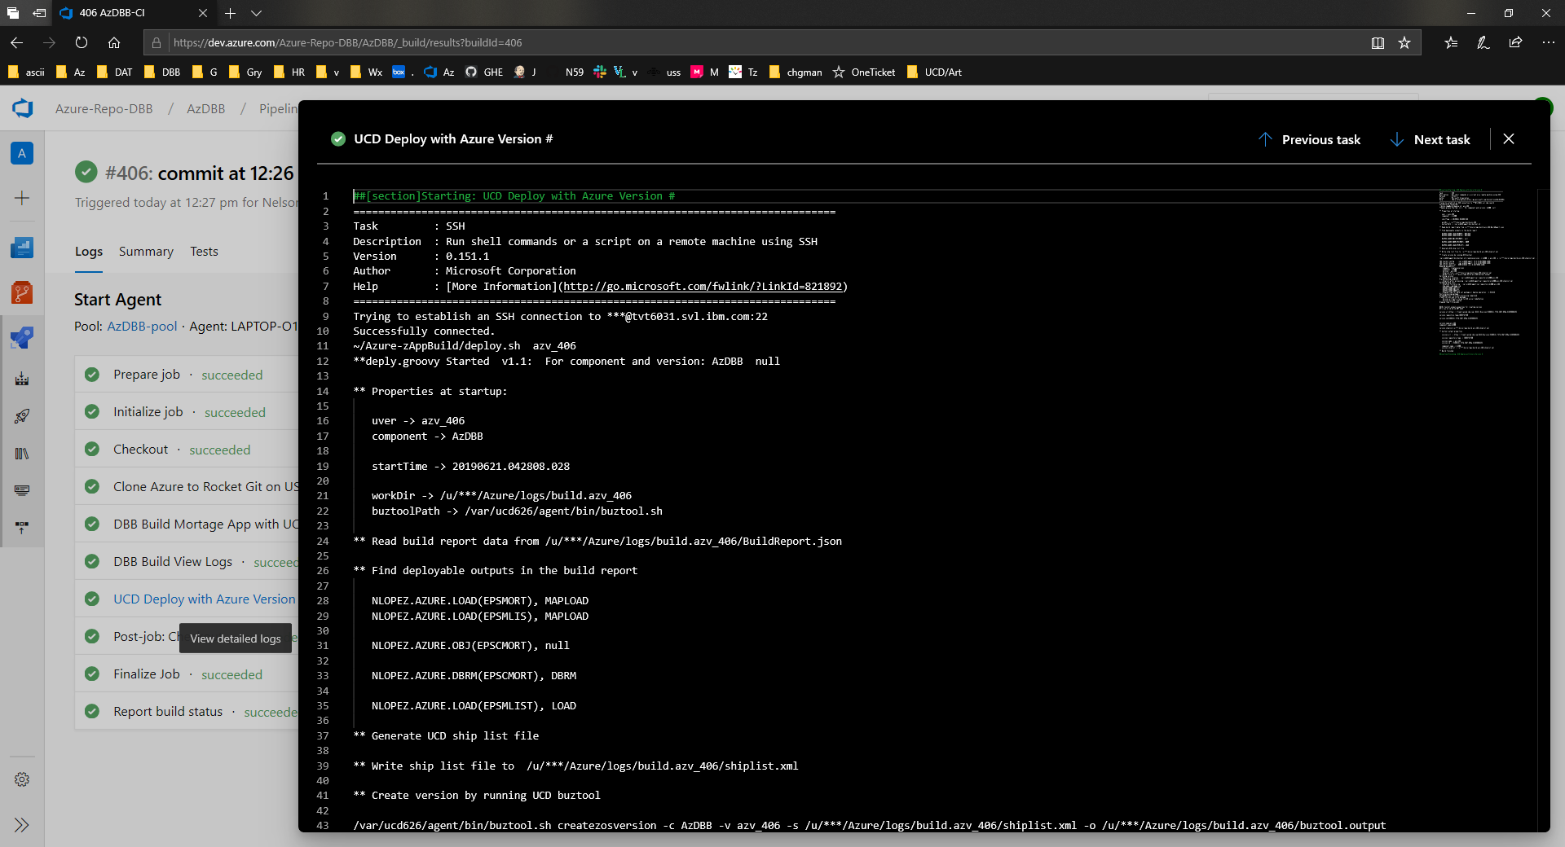
The Pipeline starts a USS Script to Clone the Azure Repo on USS (C), run a DBB Build (D) and run buztool to publish the build artifacts (E)
C
B
D
E
A user commit from VS Code starts an Azure DBB Pipeline

Slide 22
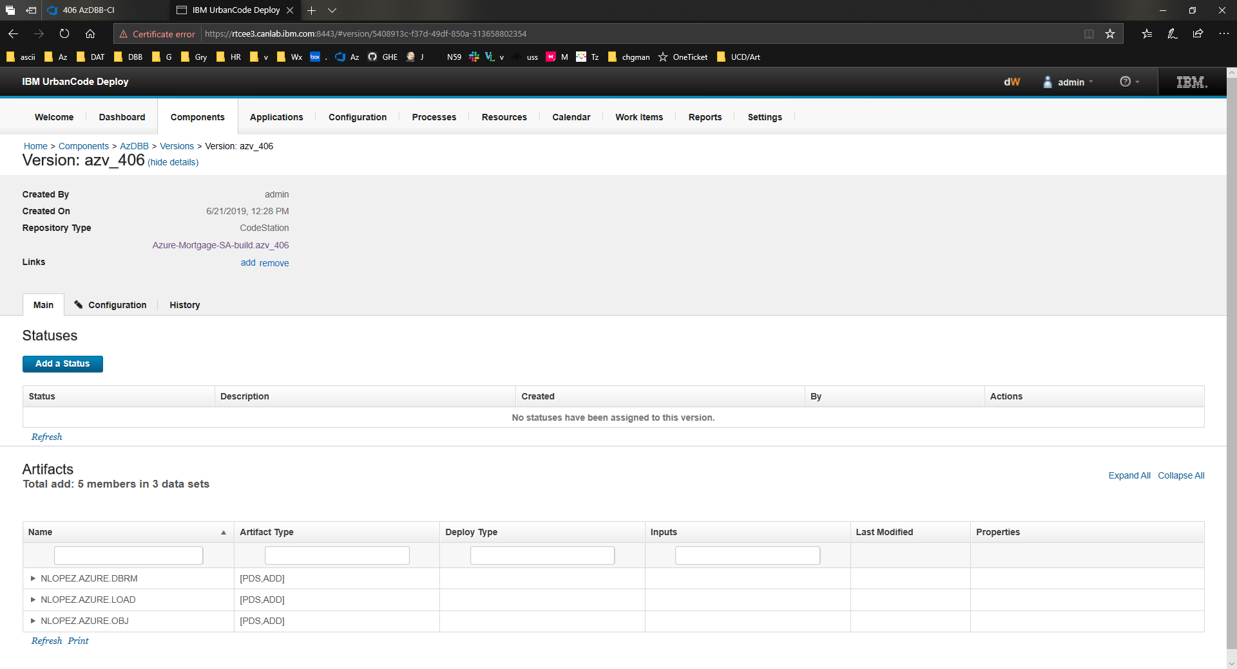
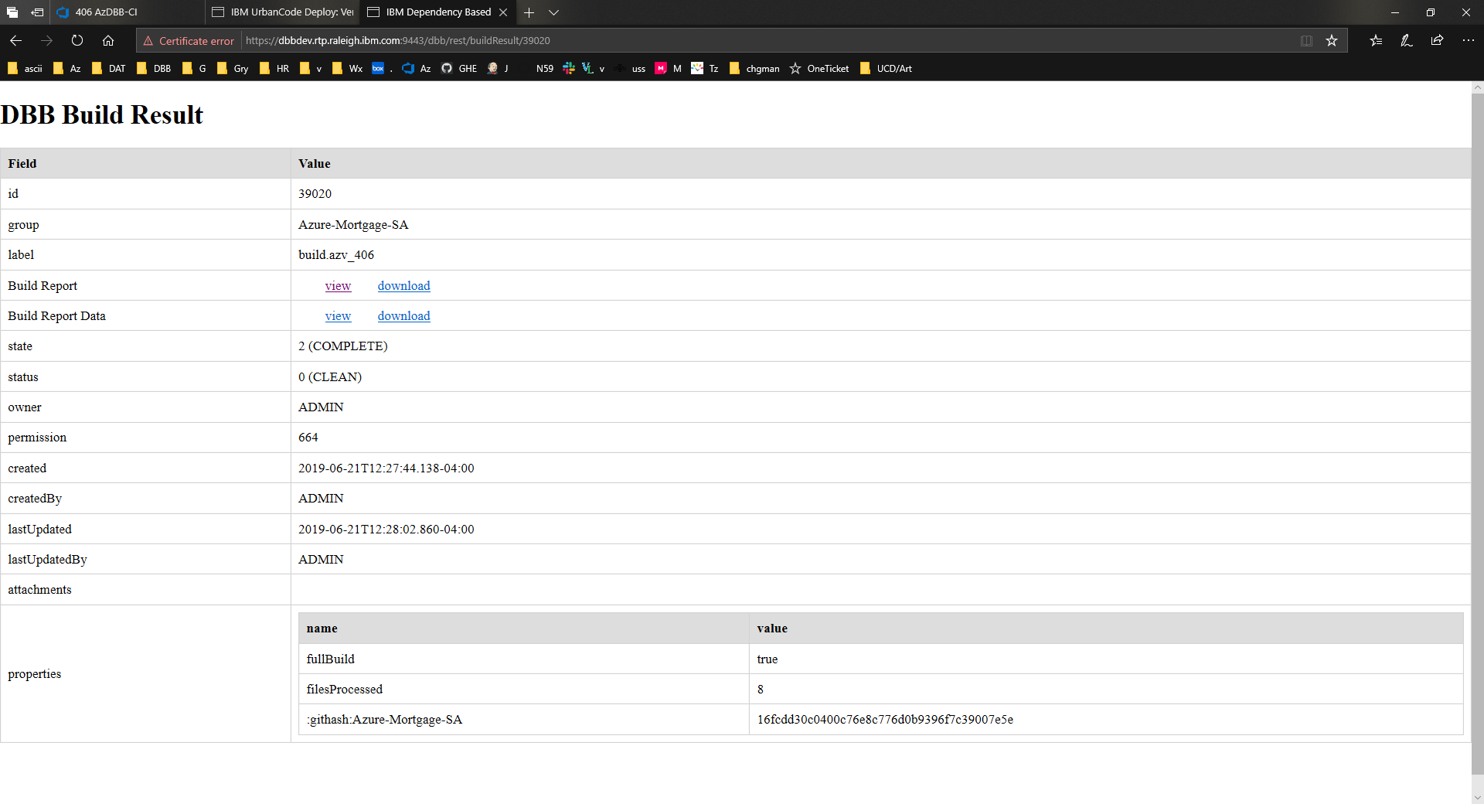
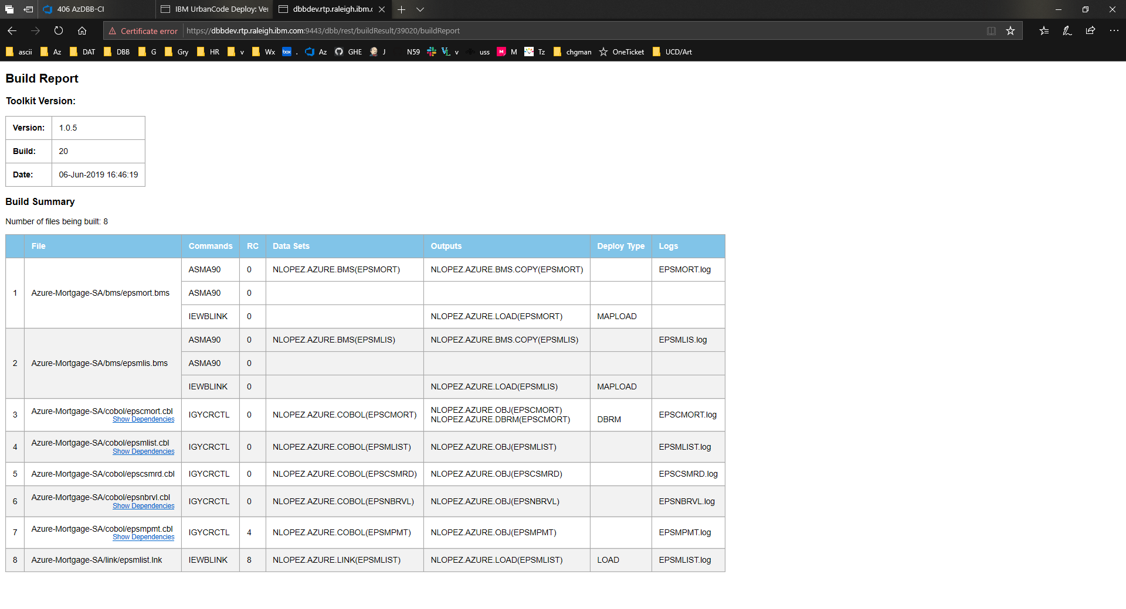
Note the Azure Build ID “406” in UCD & DBB for traceability throughout the process

Slide 23

Architecture – IBM IDz/eGit to Azure….
Developer PC
Linux Srvr
ZOS/ USS
IDz/eGit
On Prem
Linux
Azure Agent
Pipeline
Run Git Clone script
Run DBB Build
Run Urban Code Buztool
SSH
Clone Repo
C
Rocket Git repo
Developer Push Triggers a Pipeline
Developer Commits changes to Local repo
DBB Build
D
B
Artifacts
Urban Code Buztool
E
On Prem GitHub
local
Repo
User Clone to Local PC running IDz
A

Slide 24
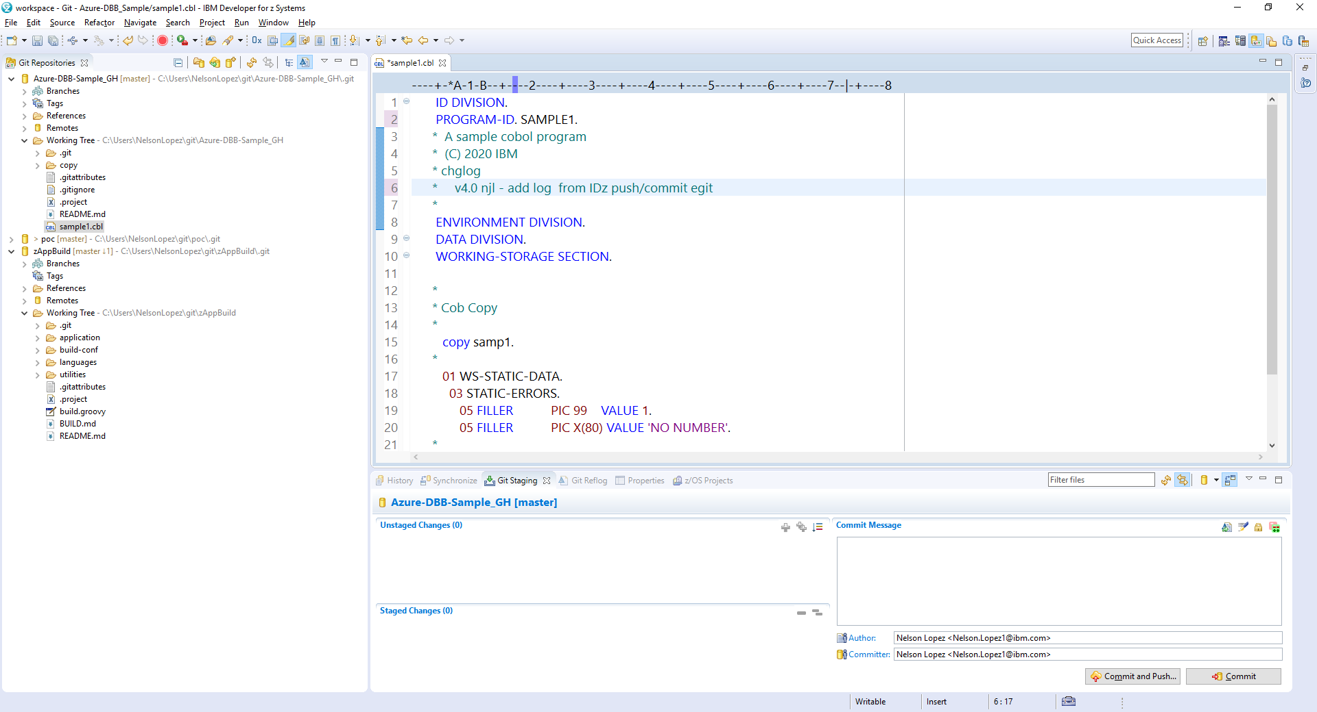
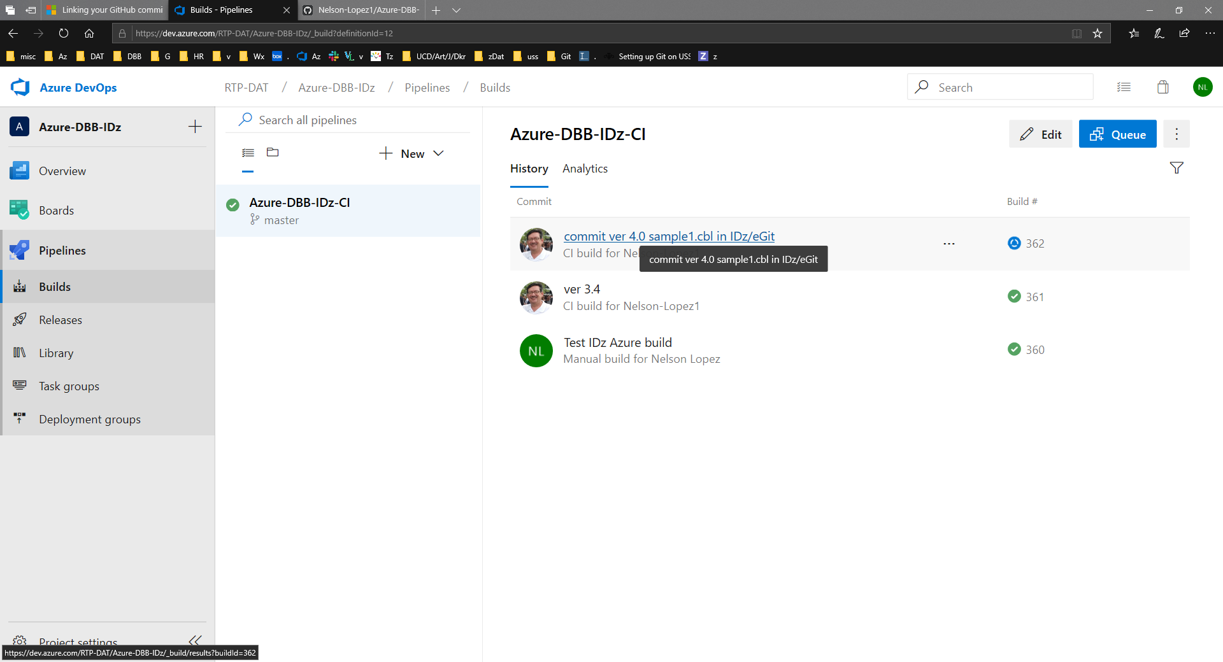
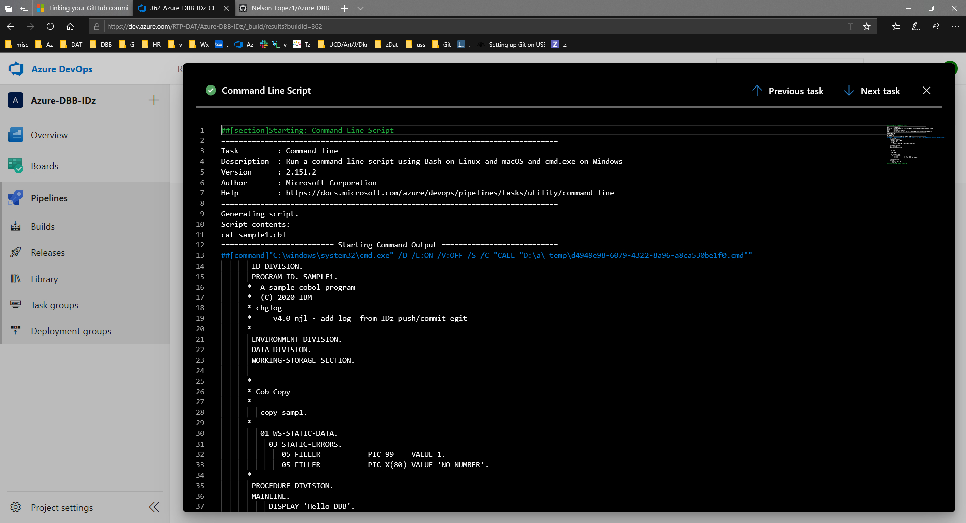
From IDz to Azure Pipeline to z/OS

Slide 25
®

